Slide 1


Analyzing the Cost of Living in the United States
CS5593 - Data Mining
3rd Semester, Fall 2024
GROUP MEMBERS:
Sasank Sribhashyam
Hima Deepika Mannam
Venkat Tarun Adda

Slide 2
OUTLINE
Project Overview
Introduction
Related Work
Application
Methodology: Gradient Boosting Model
Feature Selection
Challenges and Improvements
Results and Analysis: Model Comparison
Results and Analysis: Gradient Boosting Performance
Results and Analysis: Feature Importance
Demo
Conclusions & Future Work

Slide 3

Project Overview
Objective: Predict the total cost of living across U.S. regions using machine learning models.
Key Factors: Housing, food, transportation, childcare, taxes, and healthcare.
Outcome: A user-friendly application providing real-time cost predictions.
Significance: Supports decision-making for individuals, businesses, and policymakers.

Slide 4

Introduction
Motivation:
Rising costs of housing, food, and healthcare affect millions in the U.S.
Current tools lack precision and user accessibility for dynamic cost prediction.
Problem Statement:
Need for accurate, user-friendly cost prediction tools to support financial decisions for individuals, businesses, and policymakers.
Objective:
Design a robust, machine-learning-powered system for predicting regional cost of living.

Slide 5
Related Work
Previous Studies:
Regression models for cost predictions lacked real-time tools.
Research Insights:
Friedman (2001): Gradient Boosting 2019's effectiveness in capturing complex data relationships.
Domingos (2012): Challenges with noisy data and regional variations.
Contribution:
Bridging gaps with robust models and a user-friendly application.

Slide 6

Application
User-Friendly Features:
Real-time input for cost factors.
2. Instant predictions for total cost of living.
3. Dynamic visualizations for better insights.

Slide 7
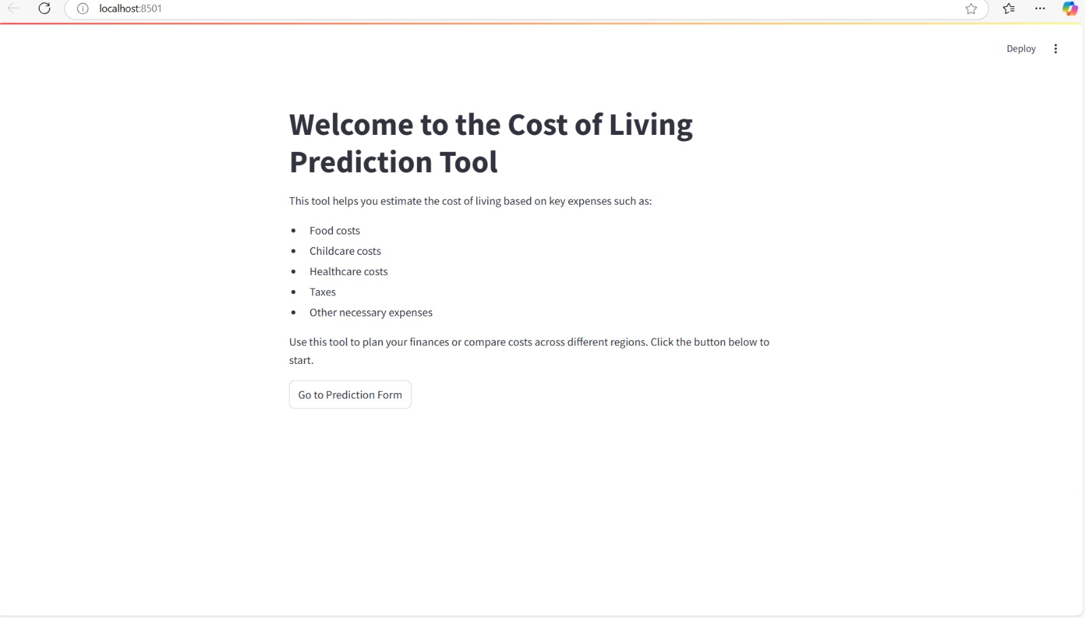

Slide 8

Methodology: Gradient Boosting Model
Why Gradient Boosting for This Project?
1. Handling Complex Relationships: Captures non-linear dependencies effectively.
2. Robustness to Noisy Data: Performs well even with real-world data imperfections.
3. Feature Prioritization: Identifies and emphasizes impactful variables.
4. Accurate Predictions: Achieved consistently high R² scores across scenarios.

Slide 9
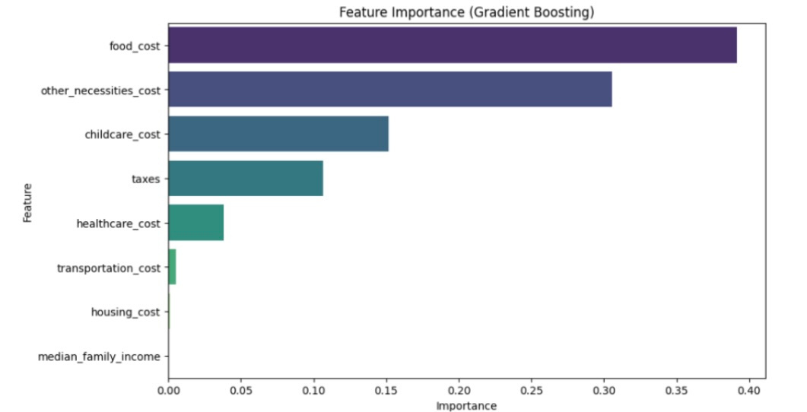

Slide 10

Feature Selection
Techniques Used:
Correlation analysis to identify impactful features.
Random Forest feature importance for ranking predictors.
Key Predictors:
Food_cost (40%), childcare_cost (20%), housing_cost (15%).
Impact:
Improved accuracy and reduced overfitting.

Slide 11
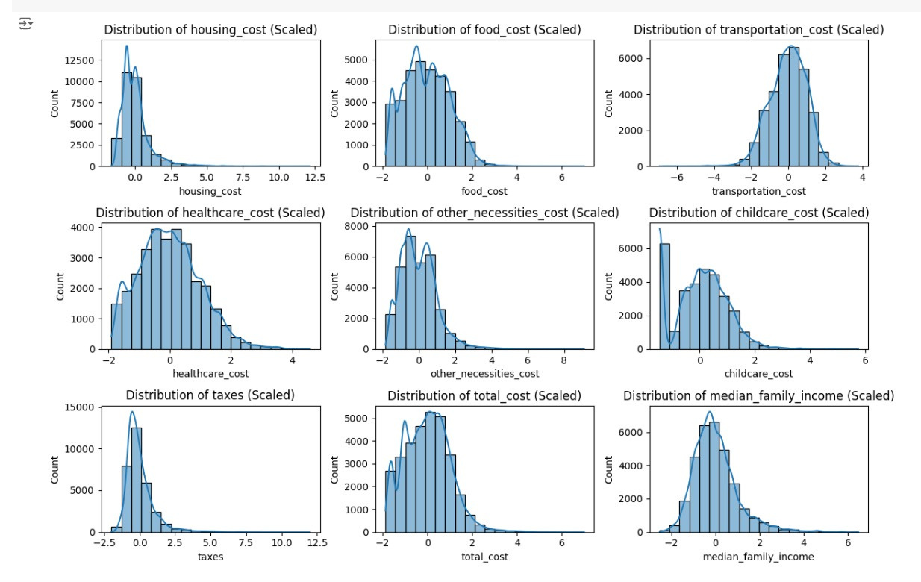

Slide 12

Challenges and Improvements
Challenges Faced:
Noisy and incomplete data.
Regional disparities in cost factors.
Solutions Implemented:
Data cleaning techniques and robust models like Gradient Boosting.
Future Enhancements:
Include more regions and factors (e.g., entertainment, environmental conditions).

Slide 13

Results and Analysis: Model Comparison
Performance on Standard Data:
Linear Regression: R² = 1.00, MSE = 0.00 (Overfit).
Ridge Regression: R² = 0.95, ideal for clean data.
Gradient Boosting: R² = 1.00, robust for non-linear relationships.
Decision Trees: R² = 0.95, prone to overfitting, MSE = 23,803,000.

Slide 14
Results and Analysis: Gradient Boosting Performance
Clean Data: R² = 1.00, MSE = 1,969,036.
Noisy Data: R² = 1.00, MSE = 2,089,898.
Non-linear Data: R² = 1.00, MSE = 2,190,498.
Key Insight: Gradient Boosting adapts to diverse data complexities.

Slide 15

Results and Analysis: Feature Importance
Top Predictors:
Food_cost (40%), childcare_cost (20%), housing_cost (15%).
Correlation Analysis:
Housing and food costs show strongest linear correlation to total cost.
Takeaway:
Prioritizing impactful features enhances prediction accuracy.

Slide 16
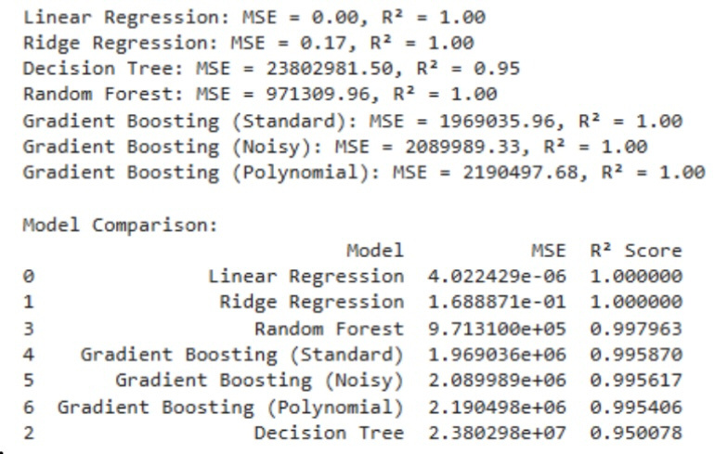

Slide 17
DEMO
Interactive Dashboard
Features:
Input fields for housing, food, and other expenses.
Predicts total cost of living with detailed breakdowns.
Steps Demonstrated:
Enter data for a region.
View prediction output with bar charts and heatmaps
Adjust parameters to explore changes dynamically.

Slide 18
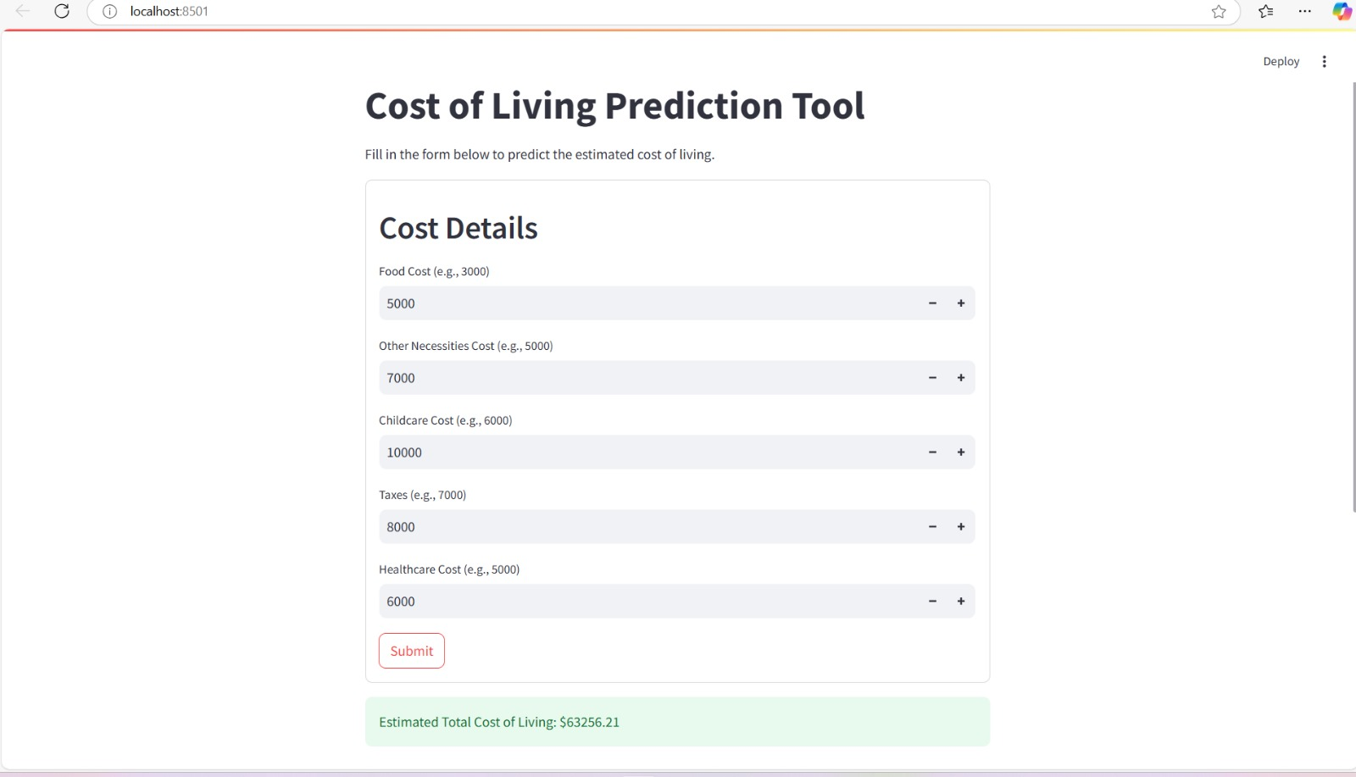

Slide 19
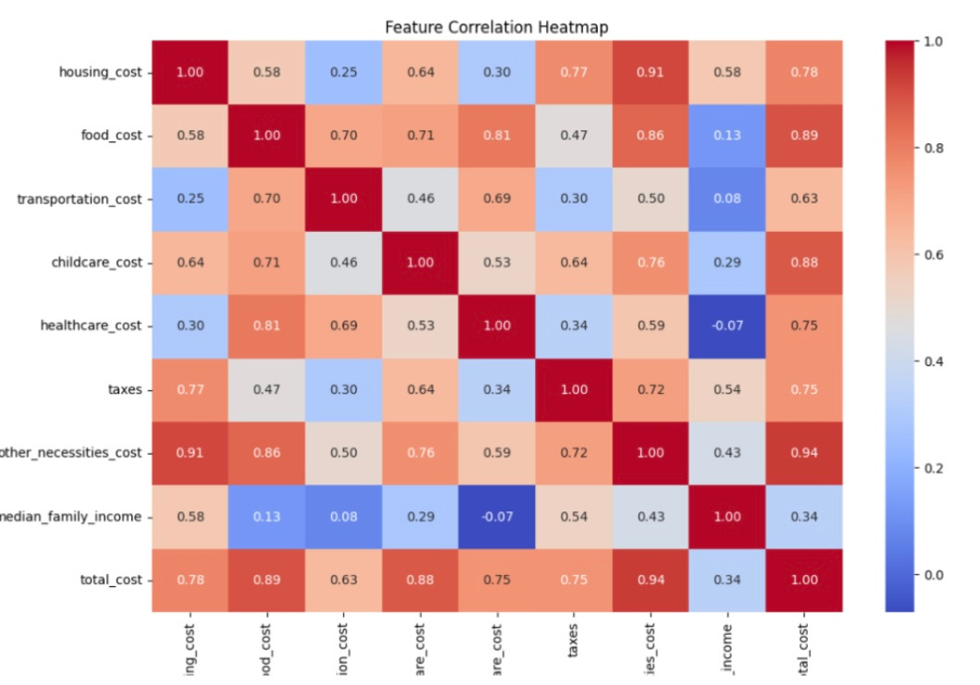

Slide 20

CONCLUSION
Achievements:
Developed a robust machine-learning-based prediction tool.
Gradient Boosting proved ideal for real-world scenarios.
User-friendly dashboard bridges analytics and usability.
Impact:
Actionable insights for financial planning, policy-making, and business strategy.
Achievements:
Developed a robust machine-learning-based prediction tool.
Gradient Boosting proved ideal for real-world scenarios.
User-friendly dashboard bridges analytics and usability.
Impact:
Actionable insights for financial planning, policy-making, and business strategy.

Slide 21
Future Work
Data Enhancements:
Integrate live data streams (e.g., inflation, market trends).
Include socioeconomic metrics like quality of life.
Technical Advancements:
Explore deep learning models (e.g., RNNs) for temporal data.
Enhance transparency with explainable AI.
User Features:
Add geospatial cost visualizations.
Expand scope to include affordability indices and policy simulation
tools.

Slide 22
THANK YOU
Q&A SESSION

